Slide 1
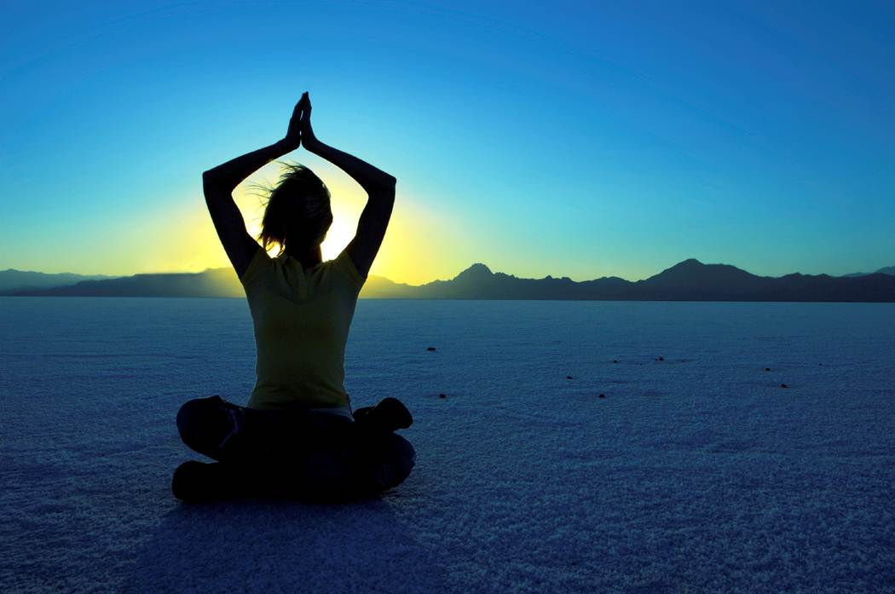
Yoga and Meditation
Unify Your Mind
Body
and Spirit

Slide 2
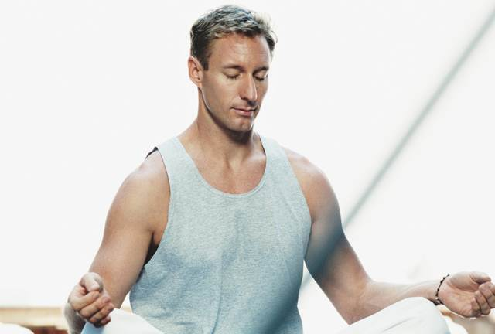
Relax and Restore
Calm the mind and boost oxygen levels in the body.

Slide 3
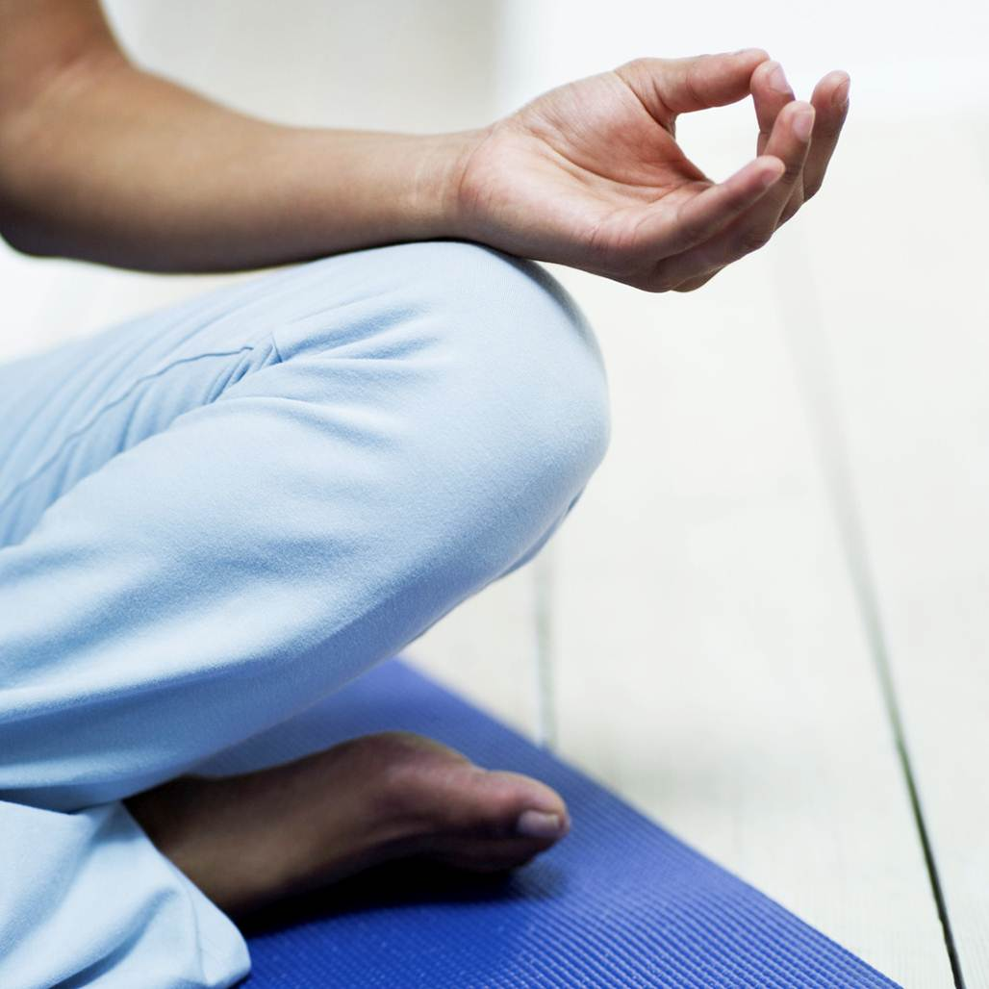
Strengthen Body
Increase flexibility and tone muscles.

Slide 4

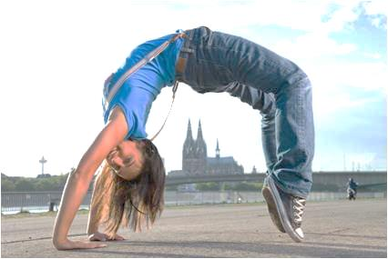

Mind
Body
Spirit
Balance

